Slide 1
Fundamentals to motion

Slide 2
Three introductory concepts

Slide 3
Vectors

Slide 4
Scalars
Scalars are numbers, and they have a single numerical value.
If I asked how many dogs do you own? You’d respond with a scalar like: 101

Slide 5
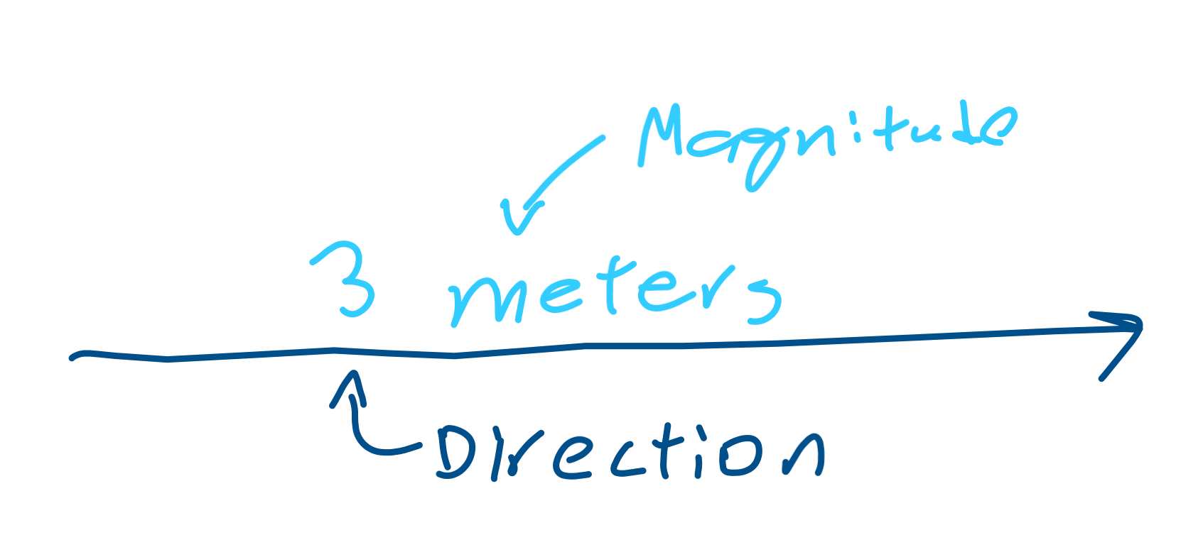
Vectors
What if I asked you instead to tell me how to get to your school? You’d probably say like to 3 miles (a scalar), but you’d also tell me to go to the east.
Vectors have 2 parts: Magnitude: how large it is (3 miles) Direction: where (east)

Slide 6
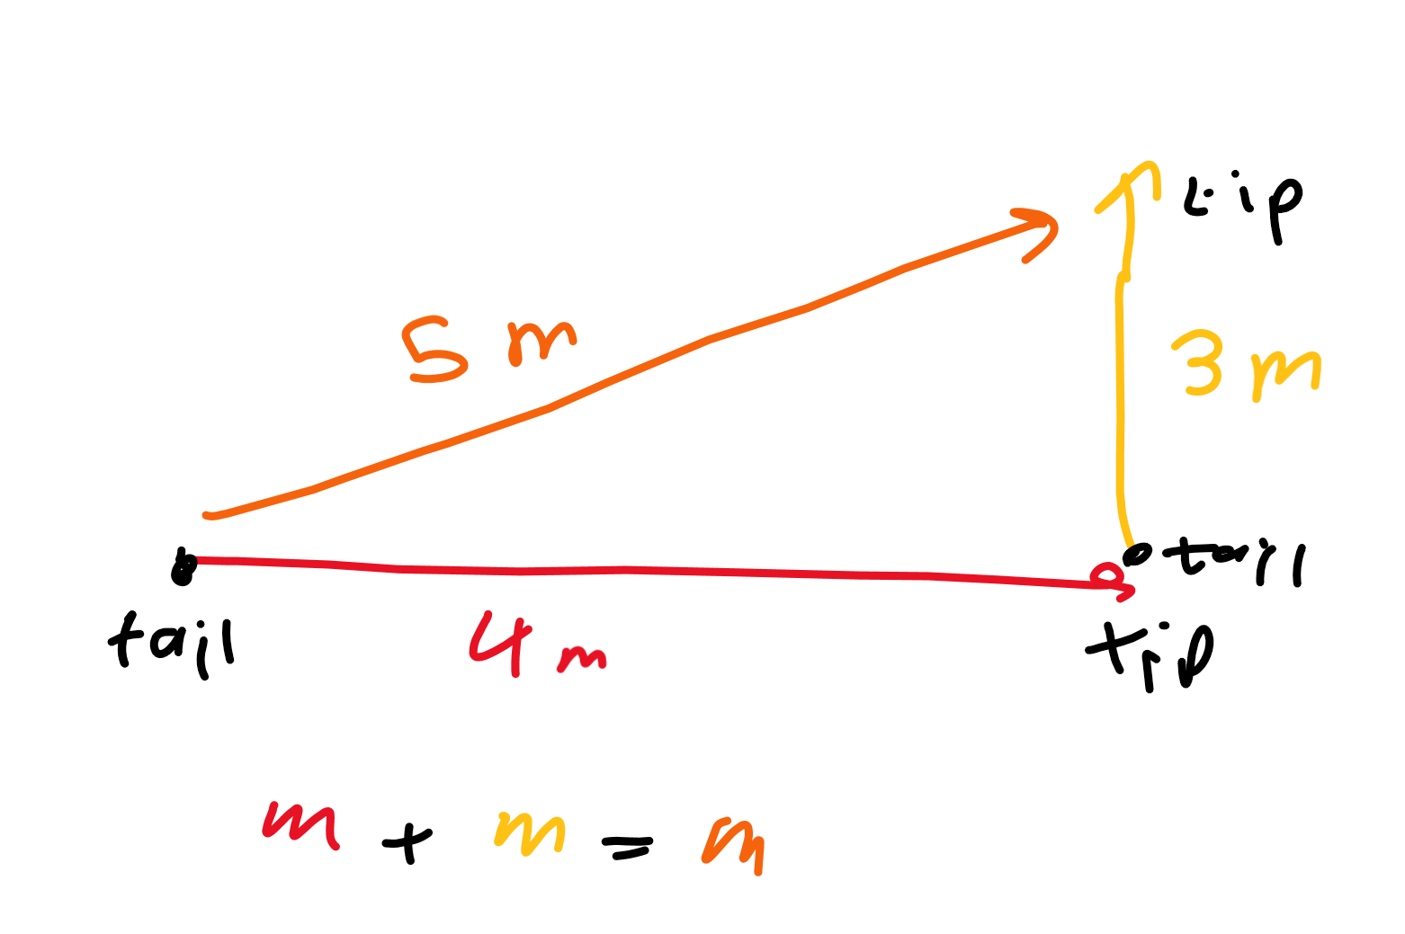
Adding vectors
Tip to tail. The sum of two vectors is a new vector made by drawing from the tail of one to the tip of another.

Slide 7
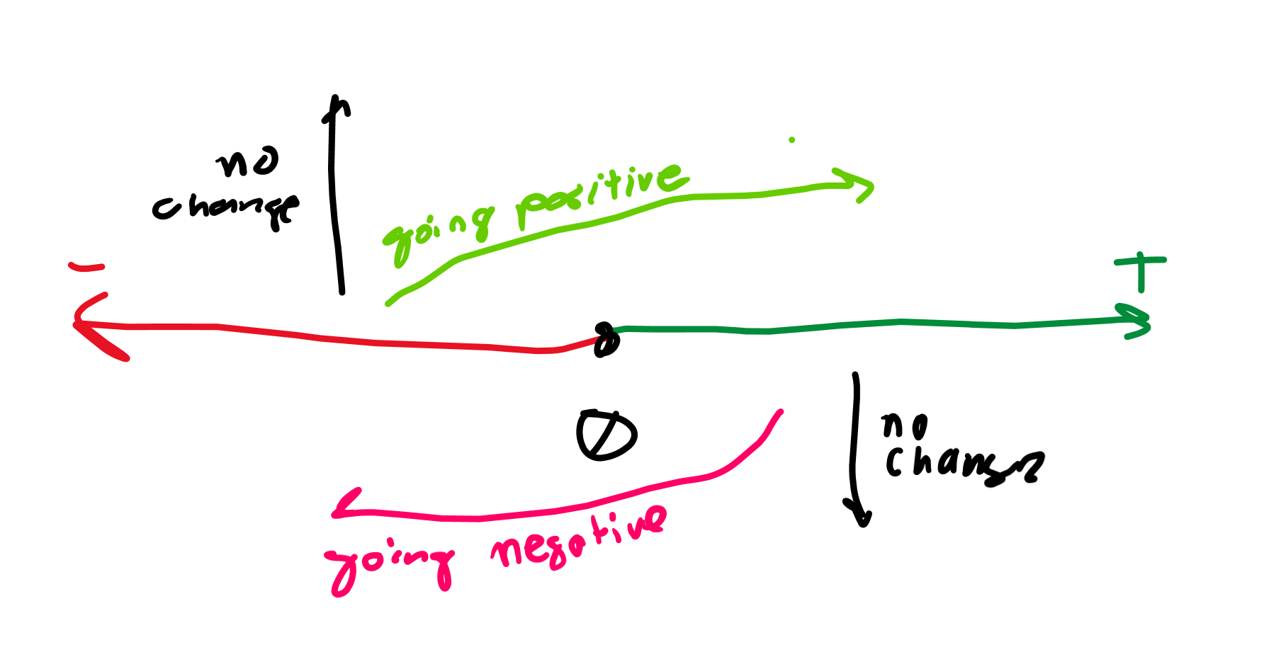
Reference points and directions
These tell you whether you are going positive or negative
If we say going right is positive, we know going left is more negative, but going up and down does not change anything

Slide 8
Derivatives

Slide 9
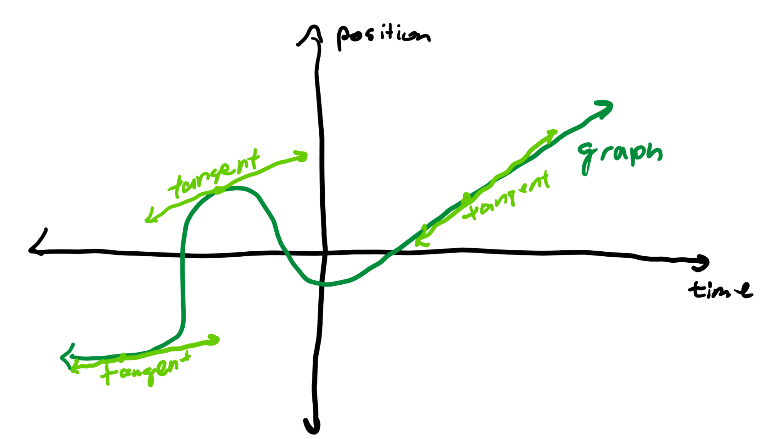
What is a derivative?
It’s a slope. On a graph, the derivative is the slope of the tangent line at a certain point.

Slide 10
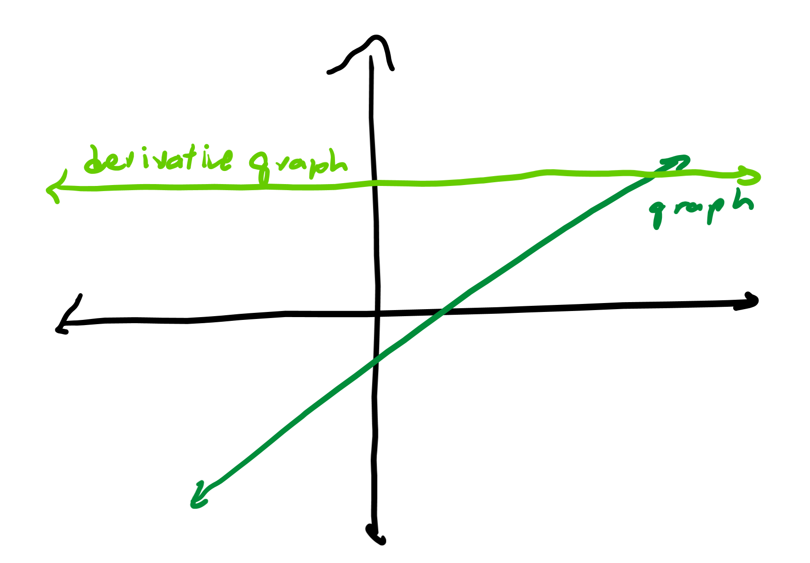
Slope of a line
We know the slope of the line f(x) = 2x would be 2, but what does that mean?
That means that the slope at every point on the line is 2, and we can graph the slope as y = 2

Slide 11
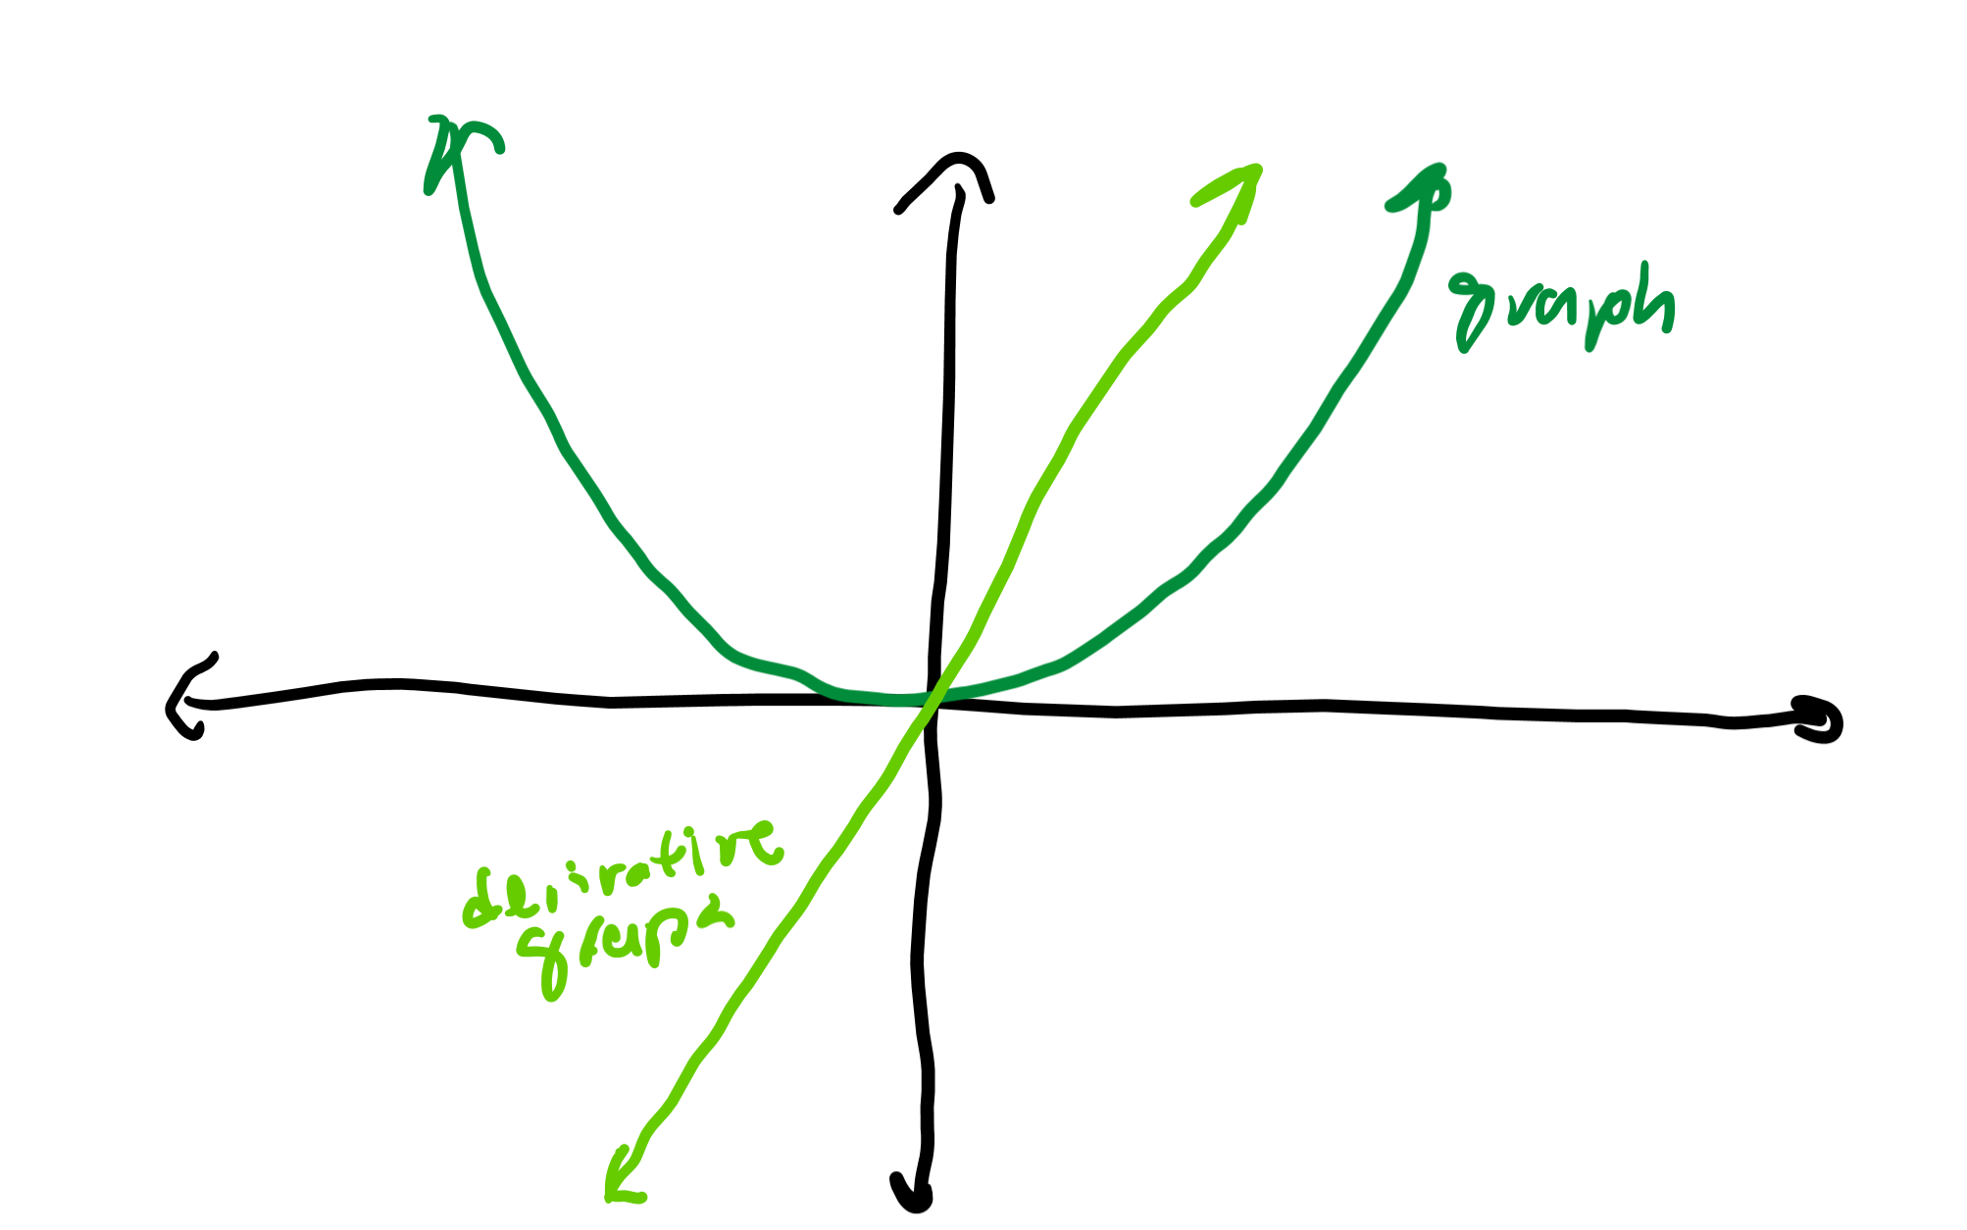
Slope of a not straight line
The slope on a curve like y = x^2 changes: first it’s very negative, then it begins to increase until it’s very positive, just like how y = 2x starts very negative but becomes positive later
You can estimate the slope at a certain point by drawing a “tangent line” that touches the curve and calculating the slope of that line

Slide 12
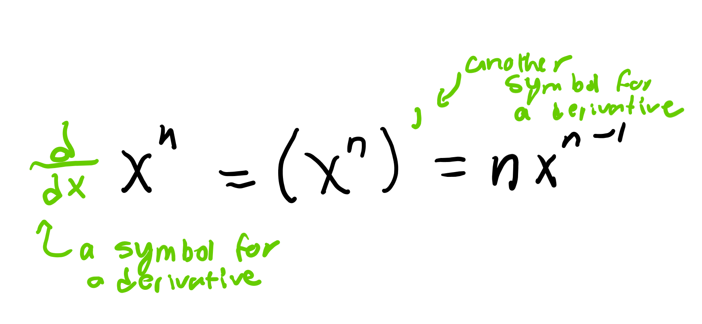
Power rule
We can use this to find the exact equation for the derivative of a curve
The derivative of x^{n} is nx^{n-1}
The derivative of x^2 is 2x and the derivative of x^7 is 7x^6

Slide 13
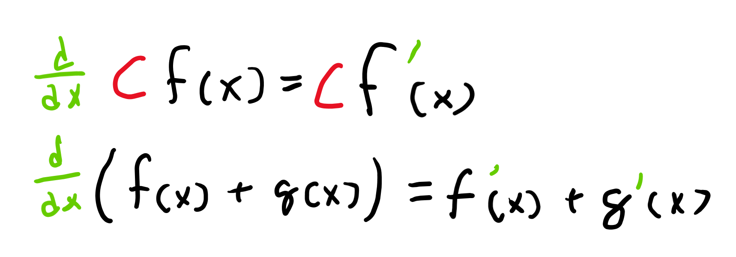
Scalar multiplication and addition
If you have something like 6x^2, the derivative is 6 * 2x = 12x.
If you have x^3 + 7x^5, the derivative is 3x^2 + 7 * (5x^4) = 3x^2 + 35x^4

Slide 14
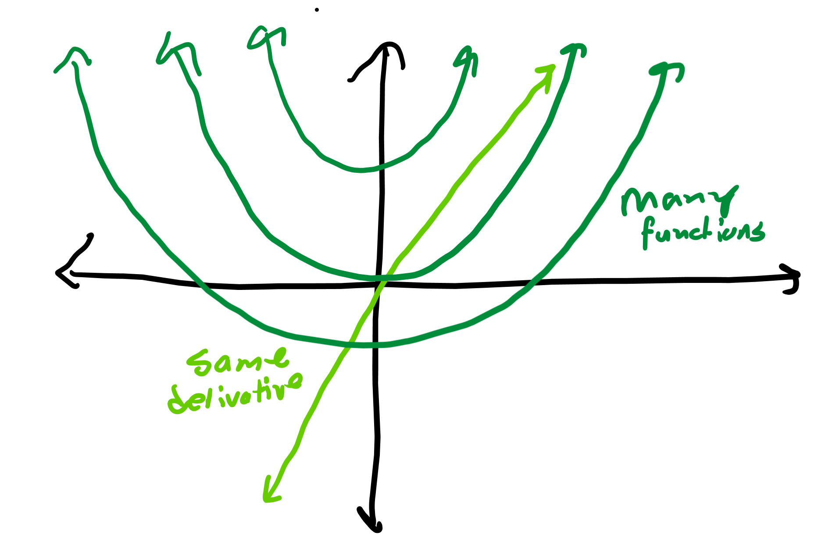
Many functions with the same derivative
x^2, x^2 + 1, x^2 + 382, etc. all have the same derivative of 2x

Slide 15
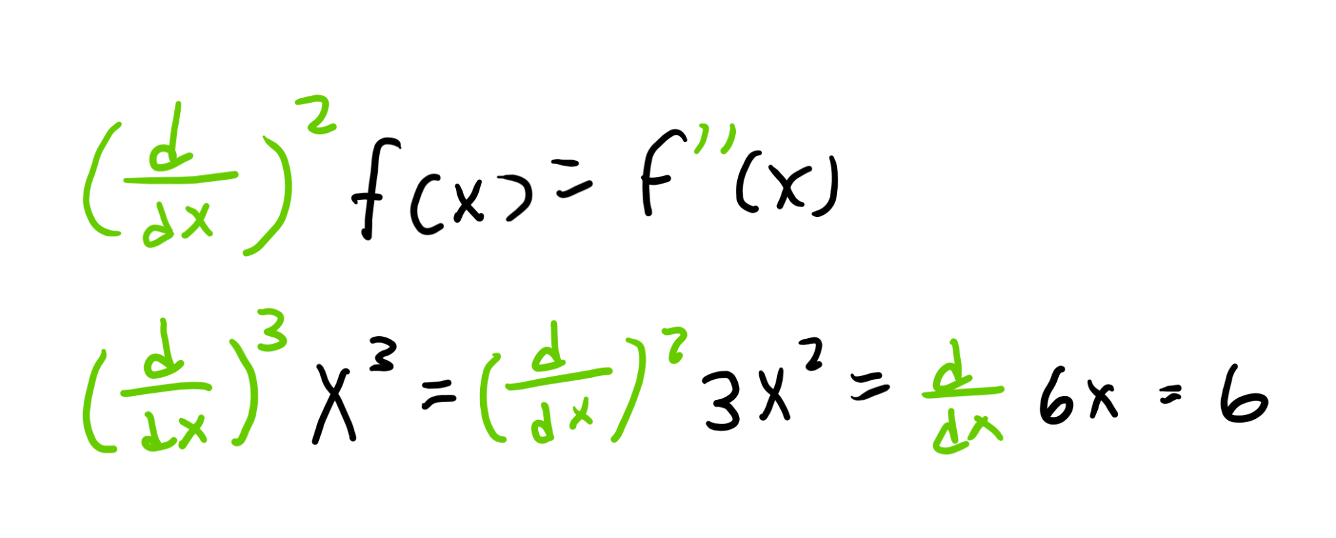
Second derivatives (and more)
You can take a derivative more than once; if you do it twice, that’s called taking the second derivative
The derivative of x^2 is 2x, so the second derivative of x^2 is the derivative of 2x, which is just 2

Slide 16
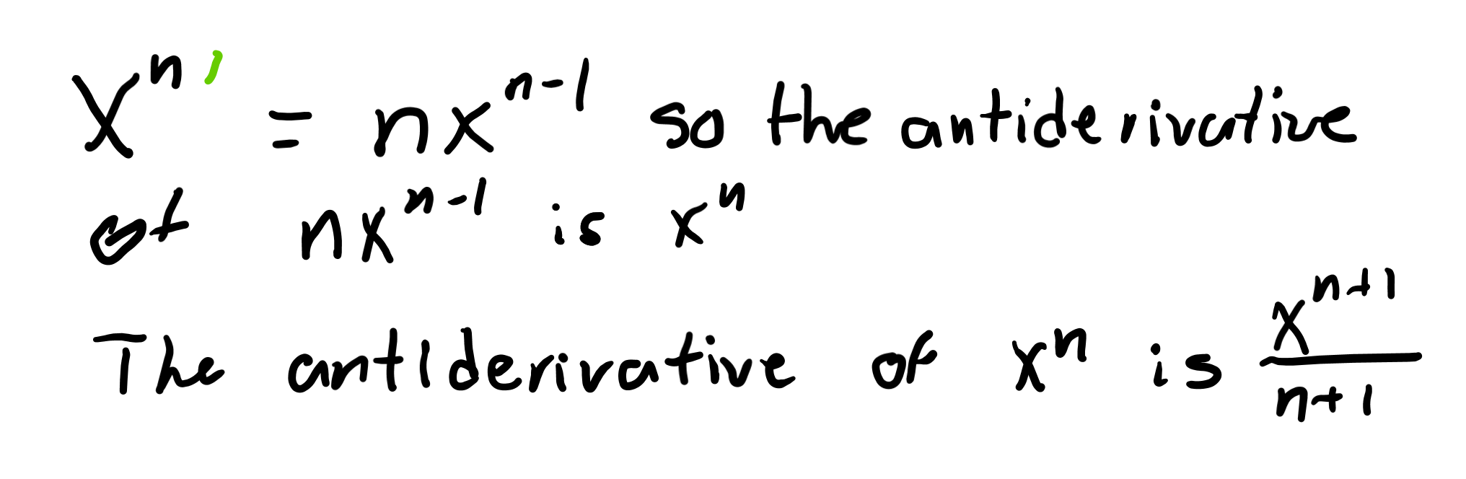
Antiderivatives
Is the antiderivative of 2x: x^2 or instead x^2 + 1?
We don’t know, so we say it’s x^2 + C where C stands for a constant

Slide 17
Units

Slide 18
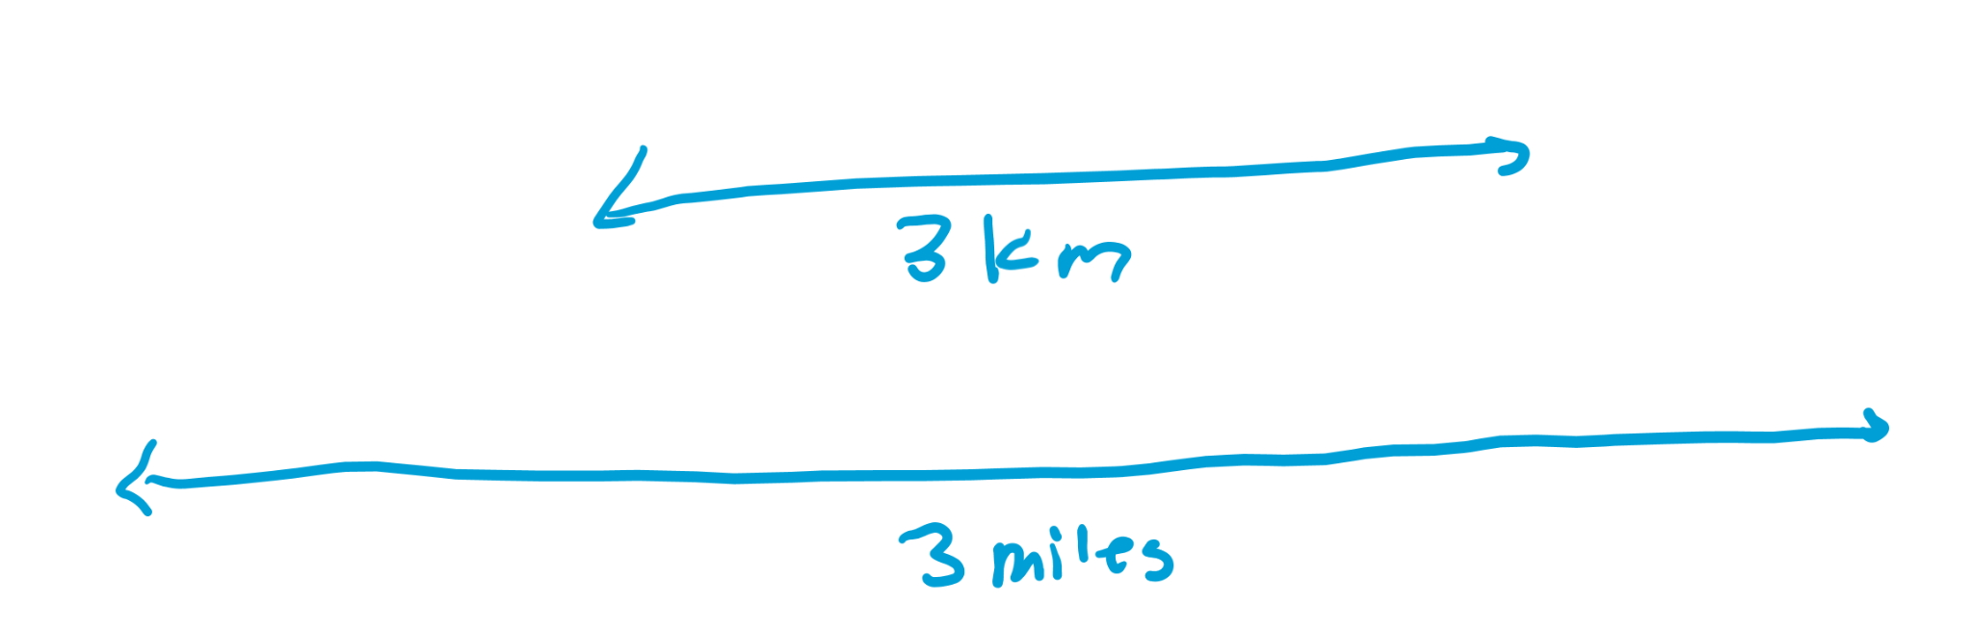
What are units
Units are a way we can measure things.
If you tell someone how far away something is, you don’t just say 3. You say 3 kilometers or 3 miles. Those are very different.

Slide 19
Using units tactically
You can manipulate calculations to get certain units. For example, 6 meters divided by 2 seconds gives 3 meters per second.
If you know speed is measured in meters per second and you are given 12 meters and 4 seconds, what is the speed?

Slide 20
Kinematics

Slide 21
Position, velocity, acceleration

Slide 22
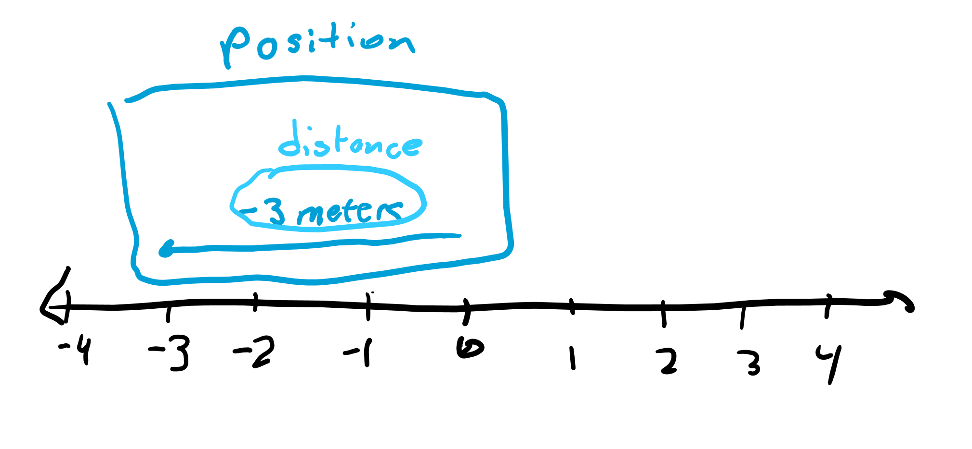
Position vs Distance
Position: a vector describing where something is from a certain reference point (a vector)
Distance: how far away something is from a certain reference point (a scalar)
Measured in meters (m)

Slide 23
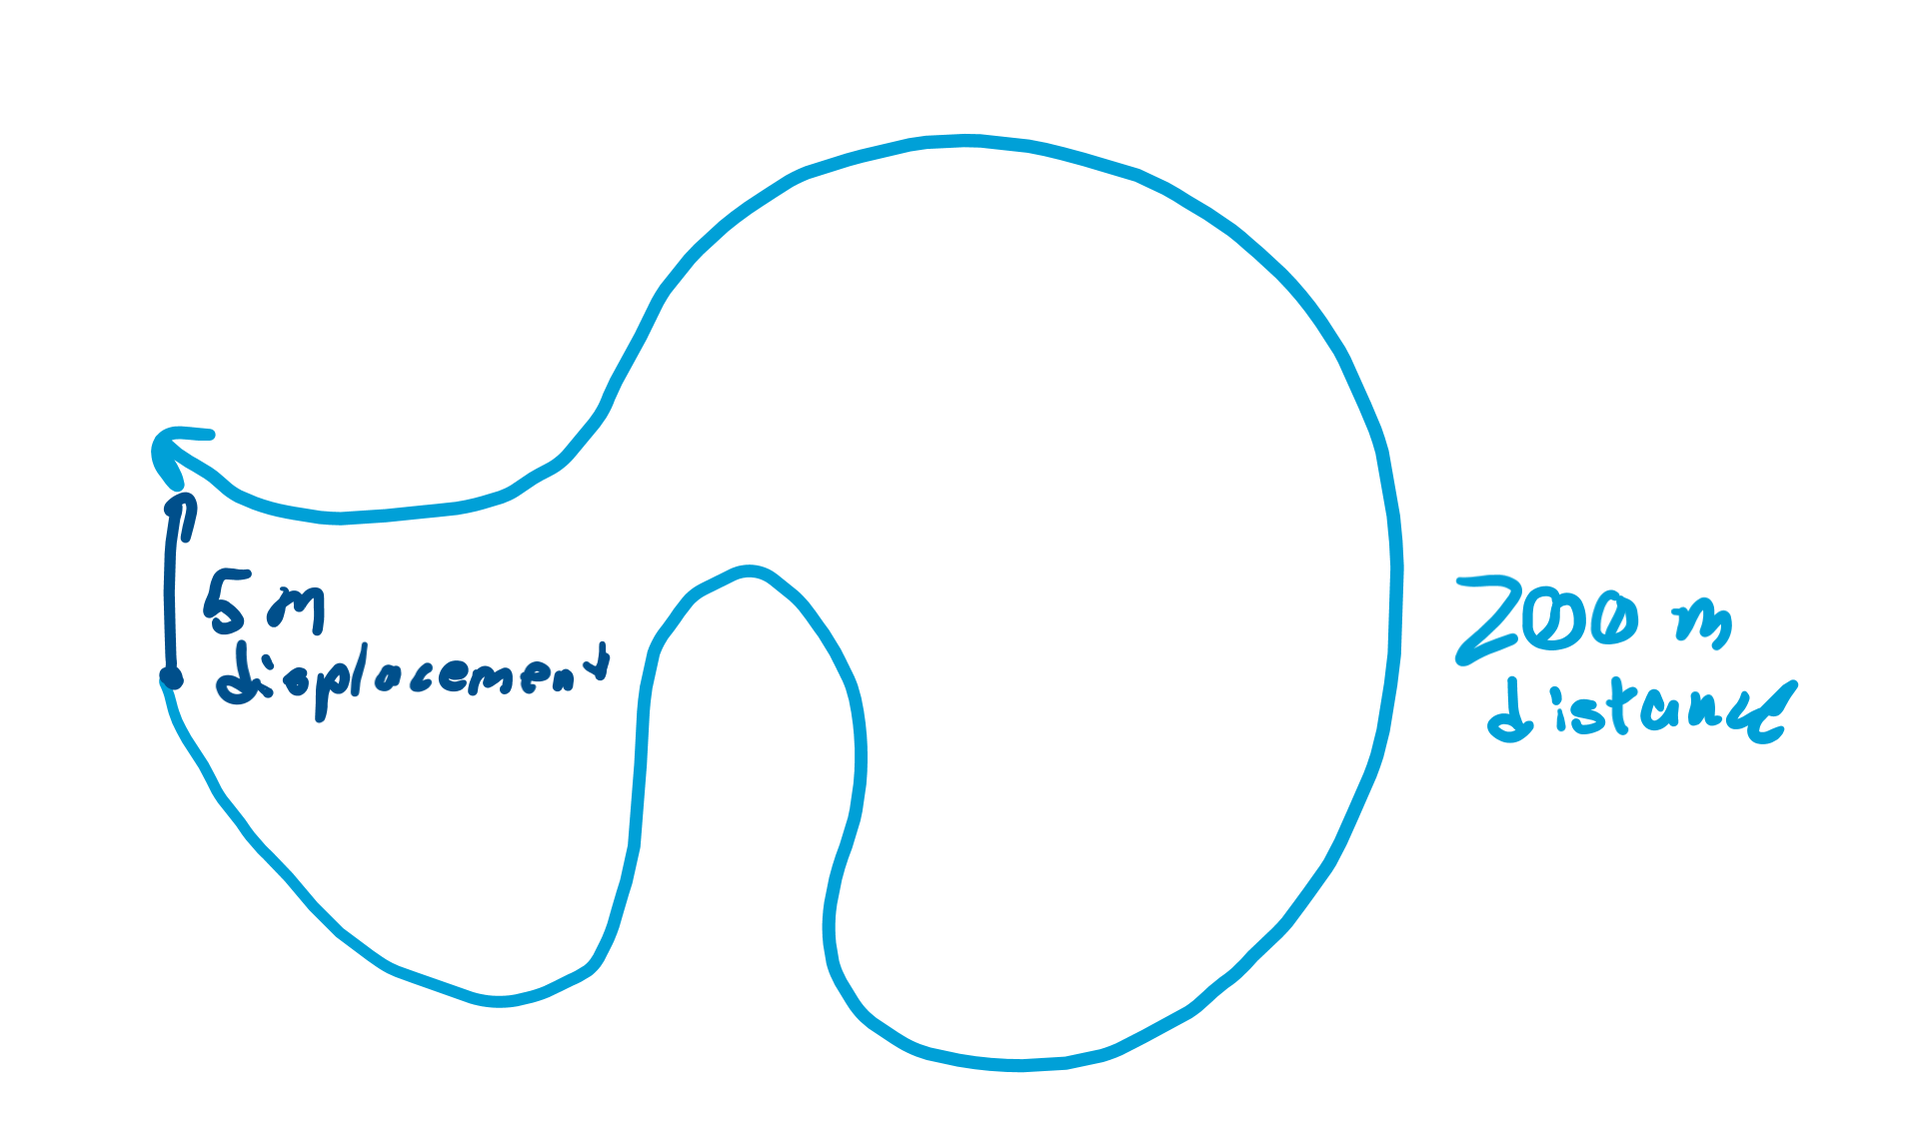
Displacement
Distance: how far you traveled in total
Displacement: how far away you ended up from where you started

Slide 24
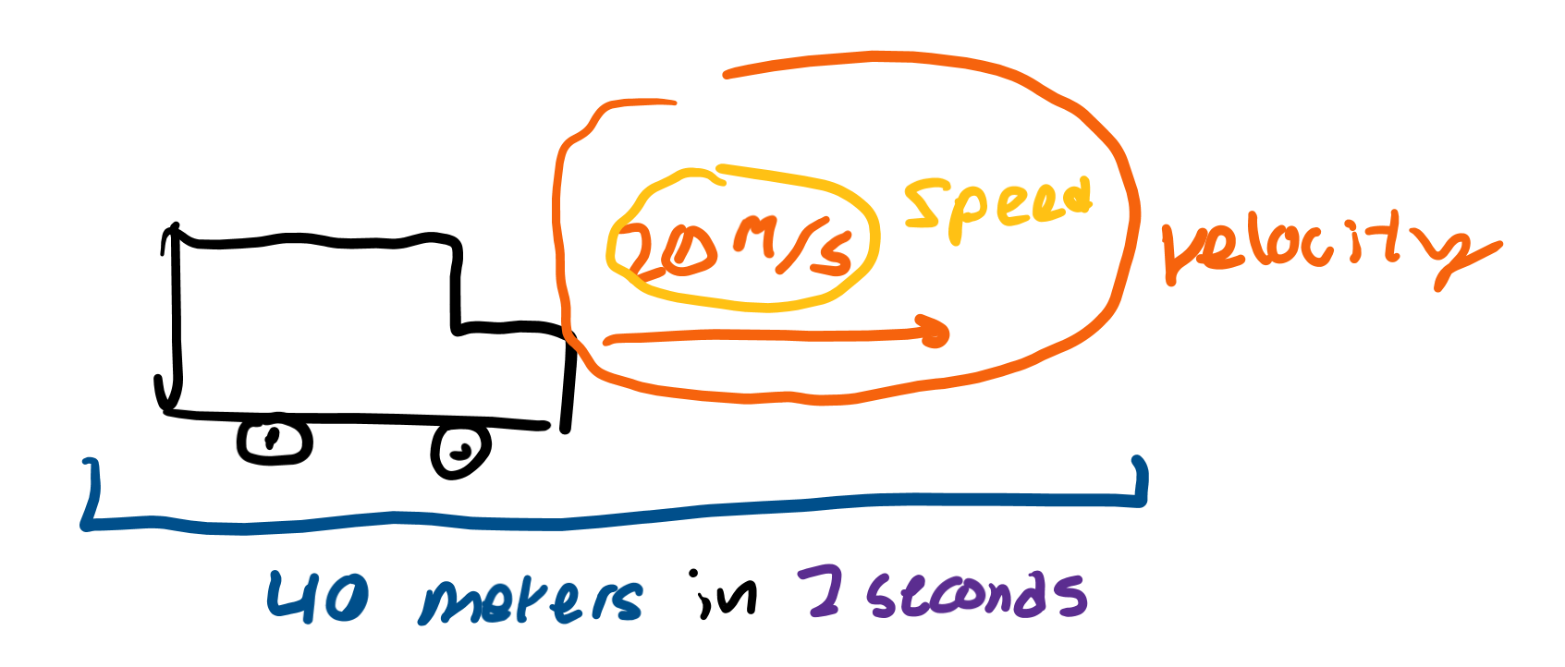
Velocity vs Speed
Velocity: a vector describing the change in position over time
Speed: a scalar describing the change in distance over time
Measured in meters divided by seconds, or meters per second (m/s)

Slide 25
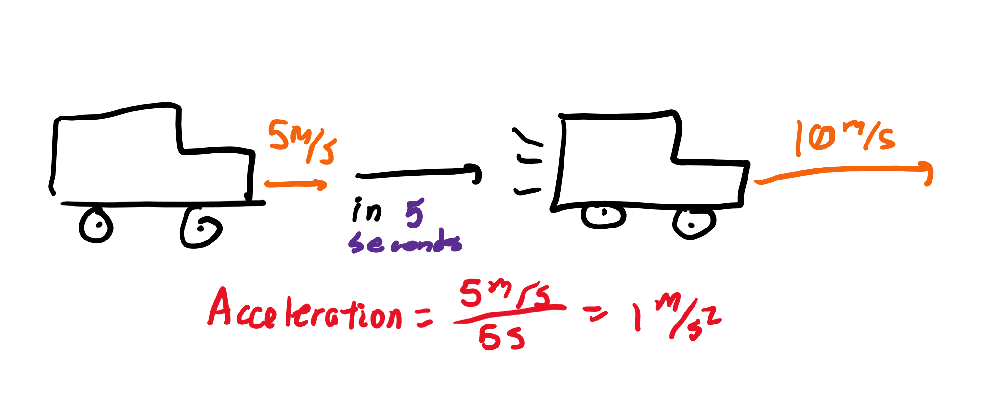
Acceleration
Change in velocity over time
How quickly your velocity is changing in a certain amount of time
Measured in meters per second per second or meters per second squared (m/s/s = m/s^2)

Slide 26
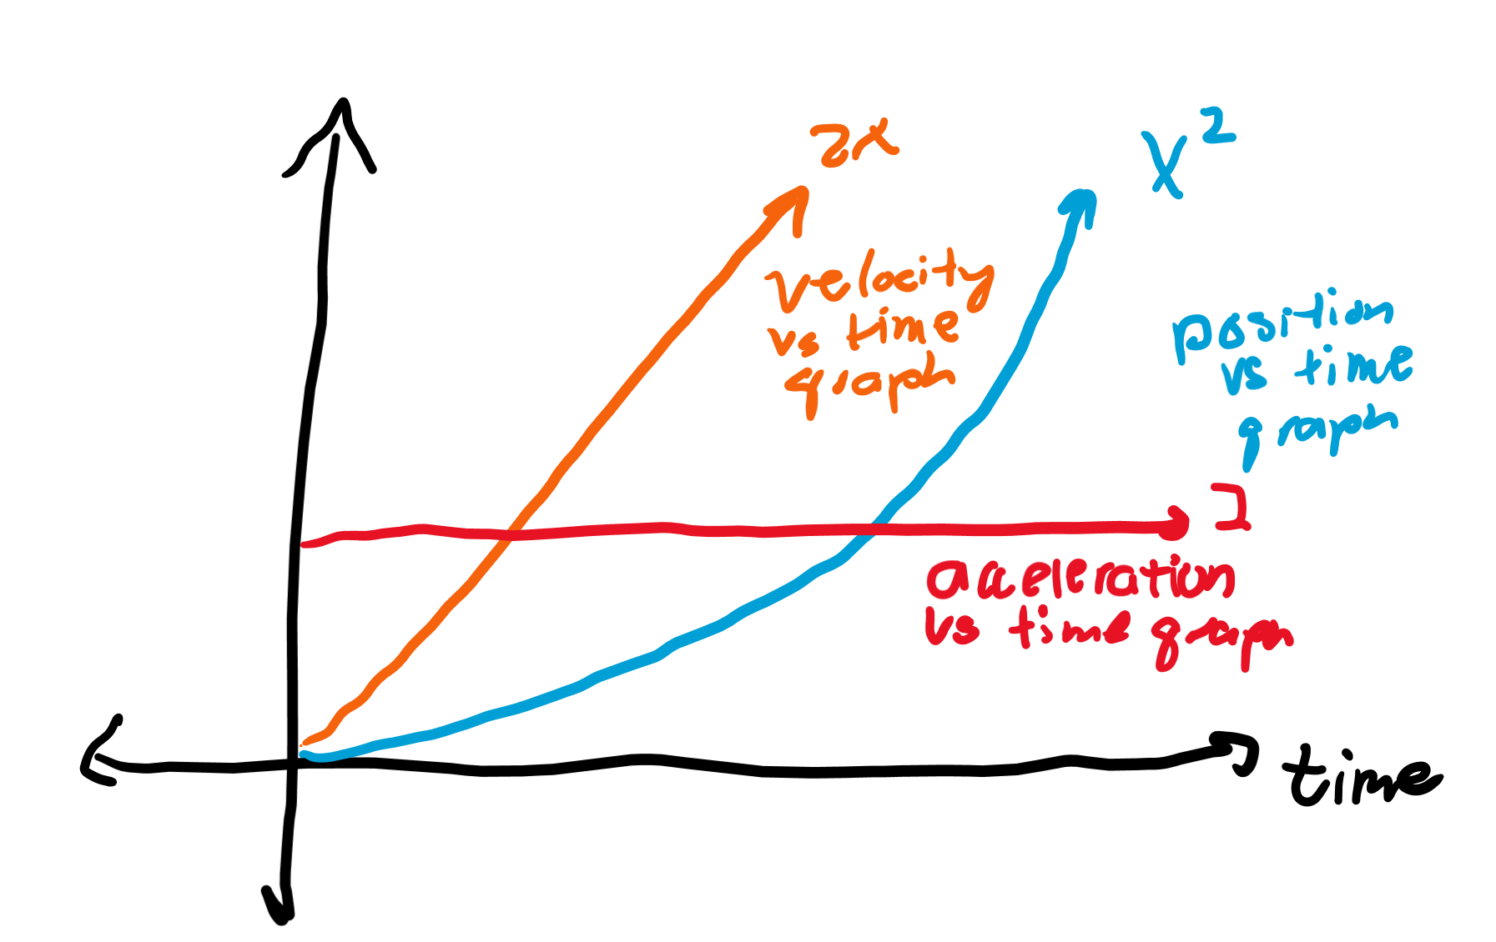
Using derivatives
The slope of a position vs time graph would be speed. The slope of a velocity vs time graph would be acceleration.
If the equation of the position vs time graph is x(t) = t^2, then you know the velocity graph is 2t.

Slide 27
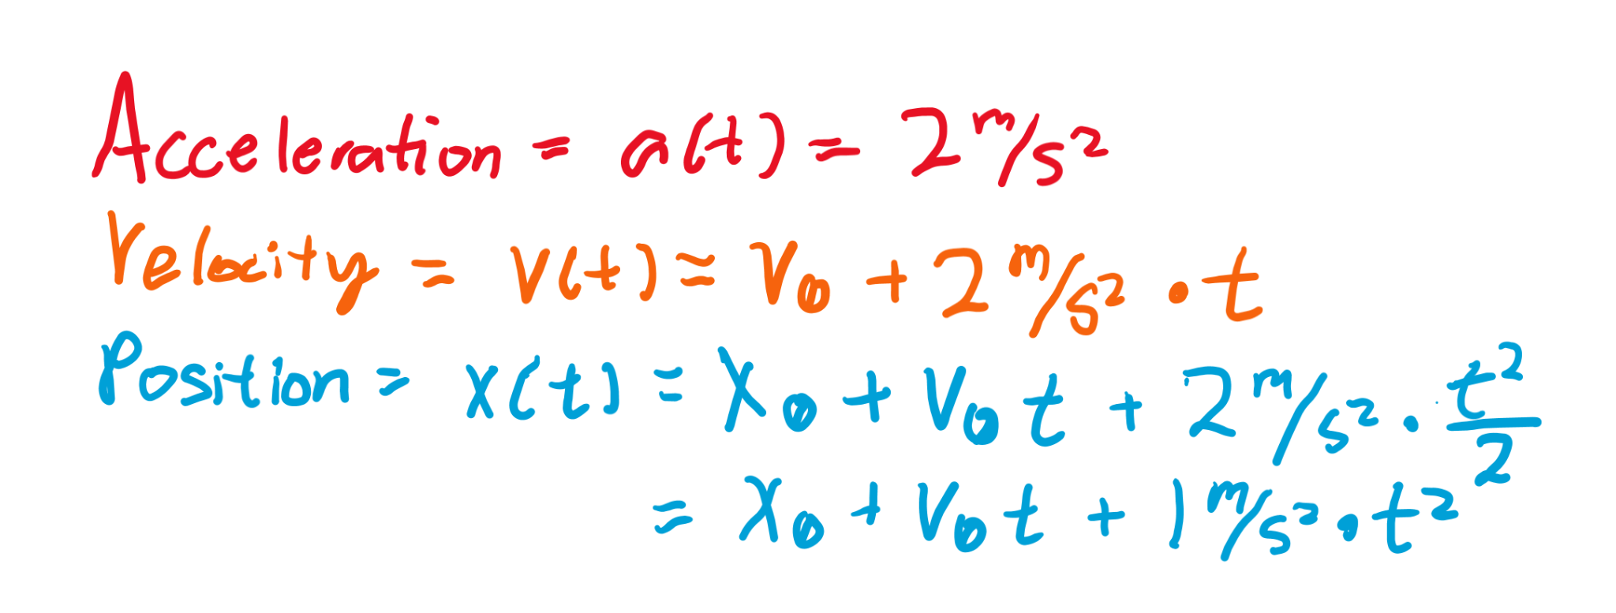
Using antiderivatives
You can go the other way as well. If you know acceleration is 4t^3, then you know velocity is t^4 + C.
If v(t) = t^4 + C, then when time is 0, we know v(0) = C, so we can instead write v(t) = t^4 + v₀ where v₀ is the initial velocity

